Slide 1




#RintisKarirImpian
Portofolio - Intensive Bootcamp
Data Analysis with PYTHON : Work with Numpy and Panda Study Cases
Owner: (Mochammad Azriel Rizky Syahputra)
Build your skill and portfolio via myskill.id/bootcamp

Slide 2
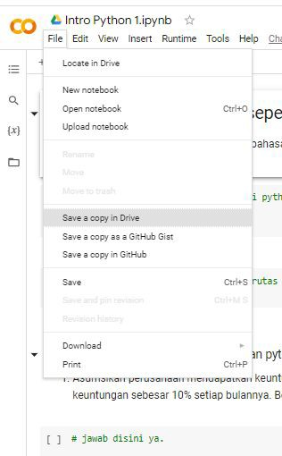

Silahkan untuk “Save a Copy in Drive” ke google drive masing-masing
Buka Google Colab ka Wijaya (click)
File > Save a copy in drive
Silahkan untuk edit dan ketik pada file colab masing-masing
Kamu juga bisa merefresh google colab tsb untuk melihat codingan terbaru
#RintisKarirImpian

Slide 3
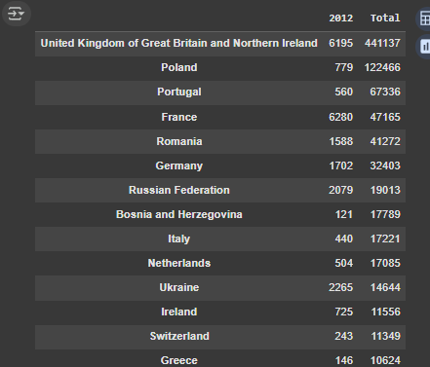
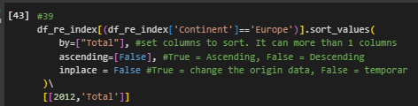
Latihan: Memfilter, Memilih, dan Mengurutkan
SILAHKAN SCREENSHOT SYNTAX DISINI
SILAHKAN SCREENSHOT HASIL DARI RUNNING TERSEBUT

Slide 4

We can easily add more countries to line plot to make meaningful comparisons immigration from different countries.
SILAHKAN SCREENSHOT SYNTAX DISINI
SILAHKAN SCREENSHOT HASIL DARI RUNNING TERSEBUT

Slide 5
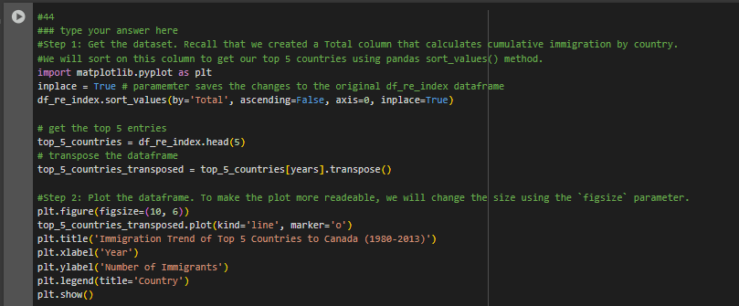
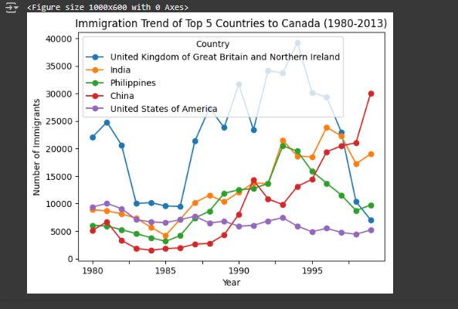
Line plot is a handy tool to display several dependent variables against one independent variable. However, it is recommended that no more than 5-10 lines on a single graph; any more than that and it becomes difficult to interpret.
SILAHKAN SCREENSHOT HASIL DARI RUNNING TERSEBUT
SILAHKAN SCREENSHOT SYNTAX DISINI

Slide 6


